Slide 1

Synthesis and Characterization of Eutectic High Entropy Alloys
Major Project Presentation for the partial fulfillment of the requirements of the B.Tech Degree
By-
Yagyaval Singh Rajput (15120082)
Satyaki Chakravorty (15120065)
Pradeep Kumar (15120053)
Abhishek Paswan (15120003)
Under guidance of –
Dr Manoj Kumar Chopkar
Department of Metallurgical Engineering
National Institute of Technology Raipur
December- 2018

Slide 2
Outline
Outline
Introduction
Literature Review
Motivation and novelty statement
Objectives
Experimental Details
Future Works
References
Ph.D. Defence Seminar

Slide 3
What is High Entropy Alloy ?
Low-Entropy Alloys
ΔS_{conf} ≤ R
Medium Entropy Alloys
R≤ΔS_{conf}≤1.5R
High Entropy Alloys
ΔS_{conf}≥1.5R
Multi-component alloys having constituents in equiatomic or near equiatomic ratios.
5-13 principal elements (atomic concentration 5% to 30%)
High softening resistance elevated temperatures & sluggish diffusion kinetics
Fig. 1 Alloy world based on configurational entropy(1)

Slide 4
How High Entropy Alloy?
High Entropy Alloys
(Structure) Lattice Distortion Effect
(Kinetics)
Sluggish Diffusion Effect
Cocktail Effect
(Thermodynamics)
High Entropy Effect
The Coring effect(3)
Ph.D. Defence Seminar

Slide 5
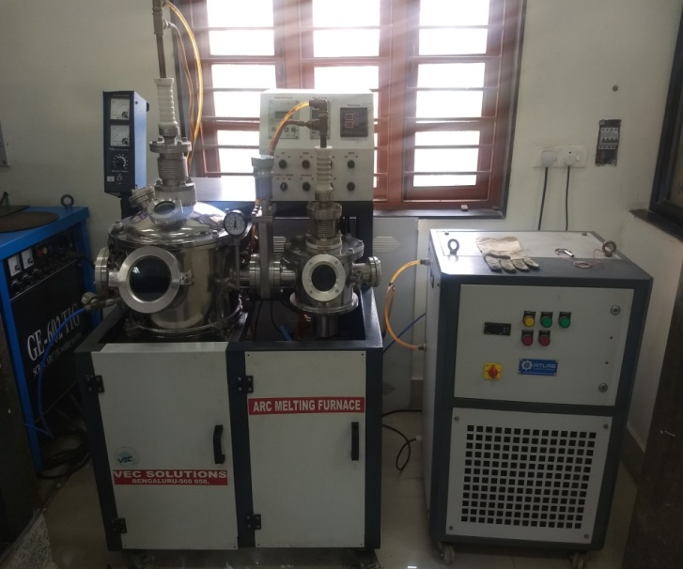
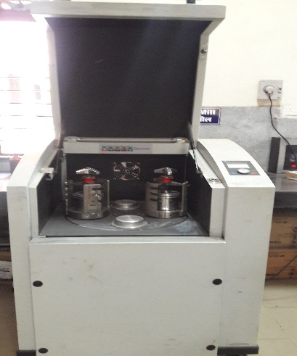
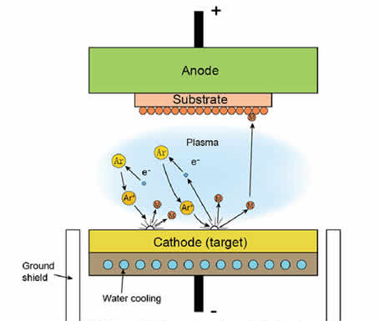
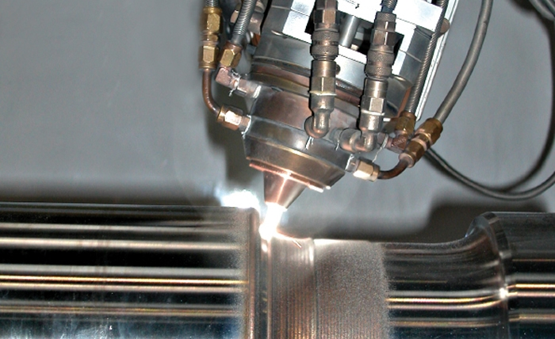
Synthesis and Processing of HEA System
MECHANICAL ALLOYING
ARC MELTING
SPUTTERING
LASER CLADDING & ELECTRO-DEPOSITION
Ph.D. Defence Seminar

Slide 6
Why High Entropy Alloy?
Major Advantages
Single phase FCC –Ductile
Single phase BCC – High yield strength
High wear resistance
High corrosion resistance
Major Disadvantages
Difficult to achieve a reasonable balance between strength & ductility
Inferior cast-ability and compositional segregation
Ph.D. Defence Seminar

Slide 7
Eutectic High Entropy Alloy
A mixture of soft fcc and hard bcc phases, to achieve the balance of high fracture strength and high ductility.
A good candidate high temperature alloys, because the eutectic solidification structure
has the following features :-
near-equilibrium & controllable microstructures
low-energy phase boundaries
high yield strength
good high-temperature creep resistance
regular lamellar or rod-like eutectic organization
better castability
Ph.D. Defence Seminar

Slide 8
Proposed Applications
Engine materials (4,5,6)
-Better elevated-temperature strength
-Oxidation resistance
-Hot corrosion resistance
Light transportation materials
-Strength
-Toughness
-Workability
Functional coatings materials
-Better wear resistance
Ph.D. Defence Seminar

Slide 9
Literature Review
Designing of EHEA’s
Two main methods :-
Calculation of phase diagrams (CALPHAD) method(2)
Experimental Method
Neither of above can be adopted due to :-
Guidelines assumptions
Complexity & inaccuracy of multi-component phase diagrams
Inaccuracy of experimental determination
Solution ???
Pseudo Binary alloy system
Ph.D. Defence Seminar

Slide 10
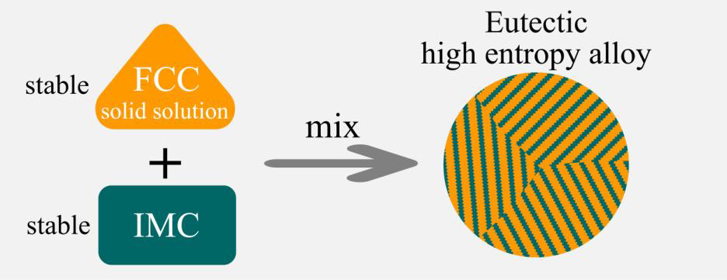
Literature Review
Pseudo Binary Alloy System
One Component
Three stable FCC-structured HEAs (CrFeCoNi2, CrFeCo2Ni, CrFe2CoNi)
Intermetallic compound(2)
With subject to conditions :-
The single-phase solid solution should be stable enough without element segregation and precipitated phase.
IMC should be stable enough from room temperature to its melting point
IMC must have the most negative enthalpy
Avoid the formation of other IMCs.
Ph.D. Defence Seminar

Slide 11
Literature Review
Design strategy :-
Designing of pseudo binary EHEA’s with FCC & BCC dual phases using thermodynamic parameters also(7,8)
Enthalpy Mix
Solid solution will form when -5KJ/mol<△Hmix<+5KJ/mol(8)
Valance electron Concentration
BCC phase will be stable when VEC<6.87
FCC phase will exist when VEC>8
BCC/FCC Dual phases will co-exist when 6.87 <VEC< 8
Ph.D. Defence Seminar

Slide 12
Motivation of The Present Work
Previously, study carried out on the Cr-Cu-Fe-Co-Ni-Si
Cr-Cu-Fe-Co-Ni₂-Si and Cr-Cu-Fe₂-Co-Ni_{2.1}-Si_{0.55} high entropy alloys.
Literature review on Cr-Cu-Fe-Co-Ni-Si, Cr-Cu-Fe-Co-Ni₂-Si and Cr-Cu-Fe₂-Co-Ni_{2.1}-Si_{0.55} HEAs suggests that addition of external elements is favorable for the changes in the microstructural and mechanical properties.
Researchers ignored the addition of non-metallic elements such as Si and focused only to regulate metallic elements for eutectic phase formation and mechanical properties improvement.
A simple and practicable method was proposed to design pseudo binary EHEAs
composed of FCC/B2 dual phases.
Ph.D. Defence Seminar

Slide 13
Objectives of the Present Study
To prepare three EHEA’s containing elements CoCrCuFeNiSi by vacuum arc melting.
To investigate the effect of silicon (Si) and nickel(Ni) addition on the
phase evolution, mechanical properties (Hardness and Wear) and corrosion behavior.
To investigate the effect of processing route on phase evolution, mechanical properties (Hardness and Wear) and corrosion behavior.
Ph.D. Defence Seminar

Slide 14
Methodology
Procurement of Elemental Powders
Consolidation
Arc Melting
Characterization of Phase Evolution
(XRD, SEM and EDS)
Characterization of Physical Properties
(Hardness and Corrosion Behavior)
Results/Data Analysis
Summary and Conclusion
Fig. The flow chart showing the steps followed for the characterization of EHEAs prepared by arc melting route.
Ph.D. Defence Seminar

Slide 15
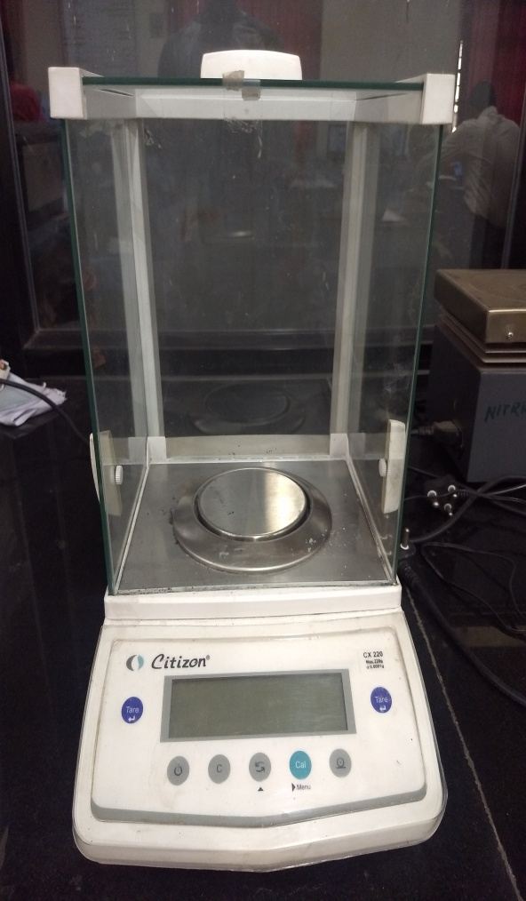
Compositional Details
1. Mixing & Weighing
The elemental powders of Co, Cu, Cr, Fe, Ni and Si were used as starting material to synthesize EHEAs
Each compositions was weighed in a total of 20 grams
Cr-Cu-Fe-Co-Ni-Si
Cr-Cu-Fe-Co-Ni₂-Si
Cr-Cu-Fe₂-Co-Ni_{2.1}-Si_{0.55}
Elements | Cr | Cu | Fe | Co | Ni | Si
Atomic Wt. % | 16.395 | 20 | 17.6 | 18.55 | 18.5 | 8.85
Elements | Cr | Cu | Fe | Co | Ni | Si
Atomic Wt. % | 13.8 | 16.9 | 14.85 | 15.65 | 31.2 | 7.45
Elements | Cr | Cu | Fe | Co | Ni | Si
Atomic Wt. % | 14.05 | 17.2 | 15.1 | 15.95 | 33.395 | 4.15
Ph.D. Defence Seminar

Slide 16
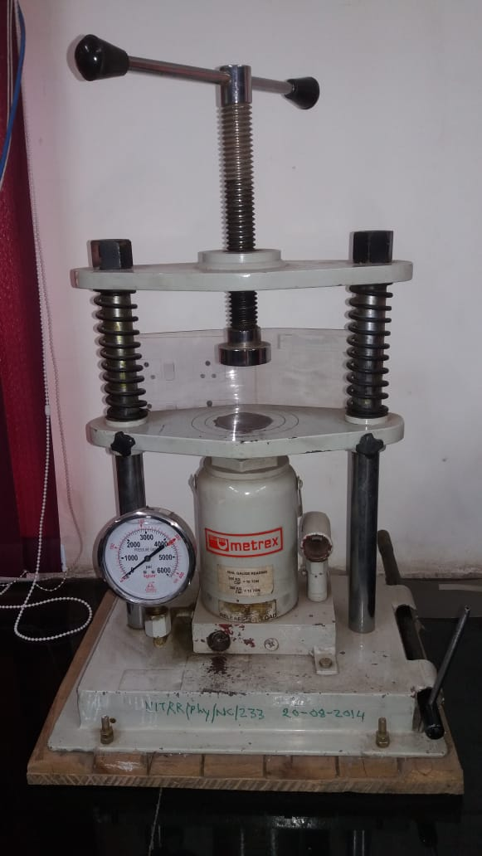
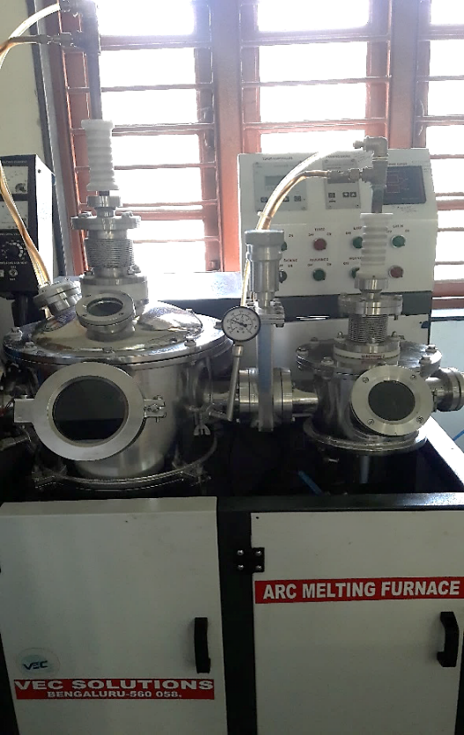
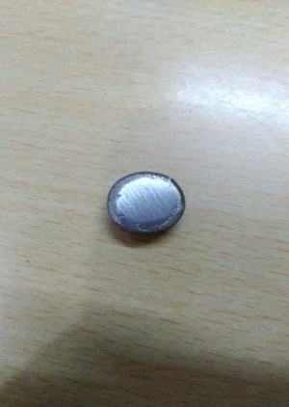
Experimental
2. Consolidation
3. Arc-Melting
Electrodes
Final product
Pressure gauge
Casting chamber
Melting chamber
Compaction pressure is 4000psi
Die size 20mm
Arc melting in a water-cooled copper hearth under
Argon atmosphere.
The arc-melted buttons were flipped and re-melted at least five times to promote thorough mixing
Ph.D. Defence Seminar

Slide 17
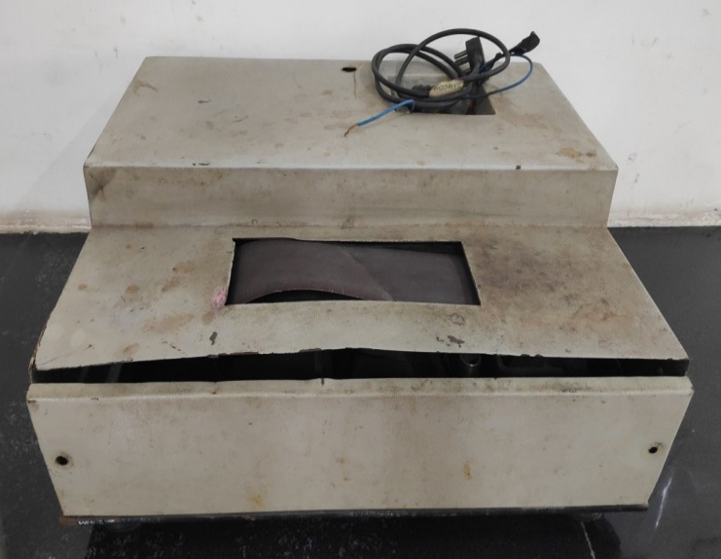
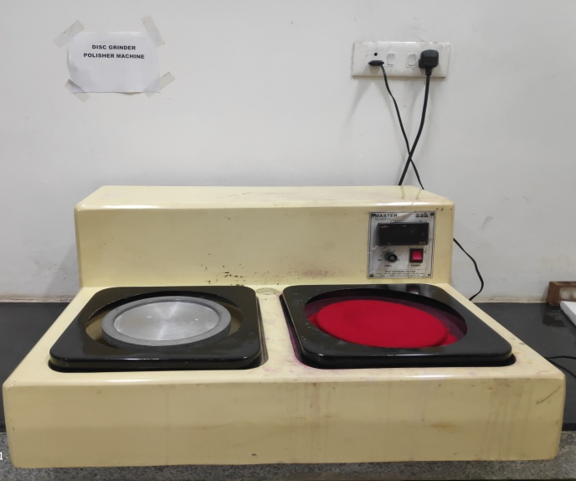
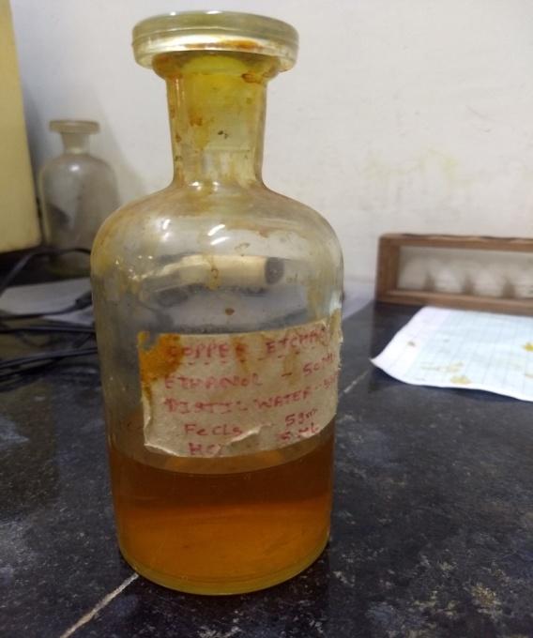
Experimental
3. Polishing & Etching
Polishing
Belt Grinder
Paper Polishing (SiC Paper)
200
400
600
1000
2000
Alumina Cloth Polishing
Etching
Copper Etchant
FeCl₃ – 5g
HCl – 5ml
Ethanol – 50ml
Distilled water – 50ml
Ph.D. Defence Seminar

Slide 18

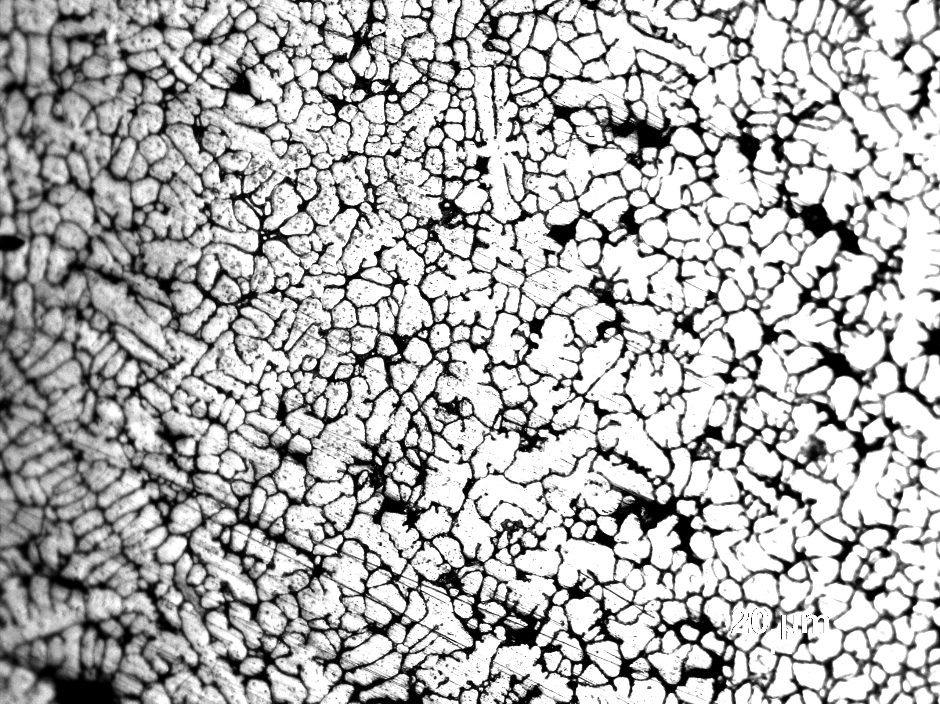
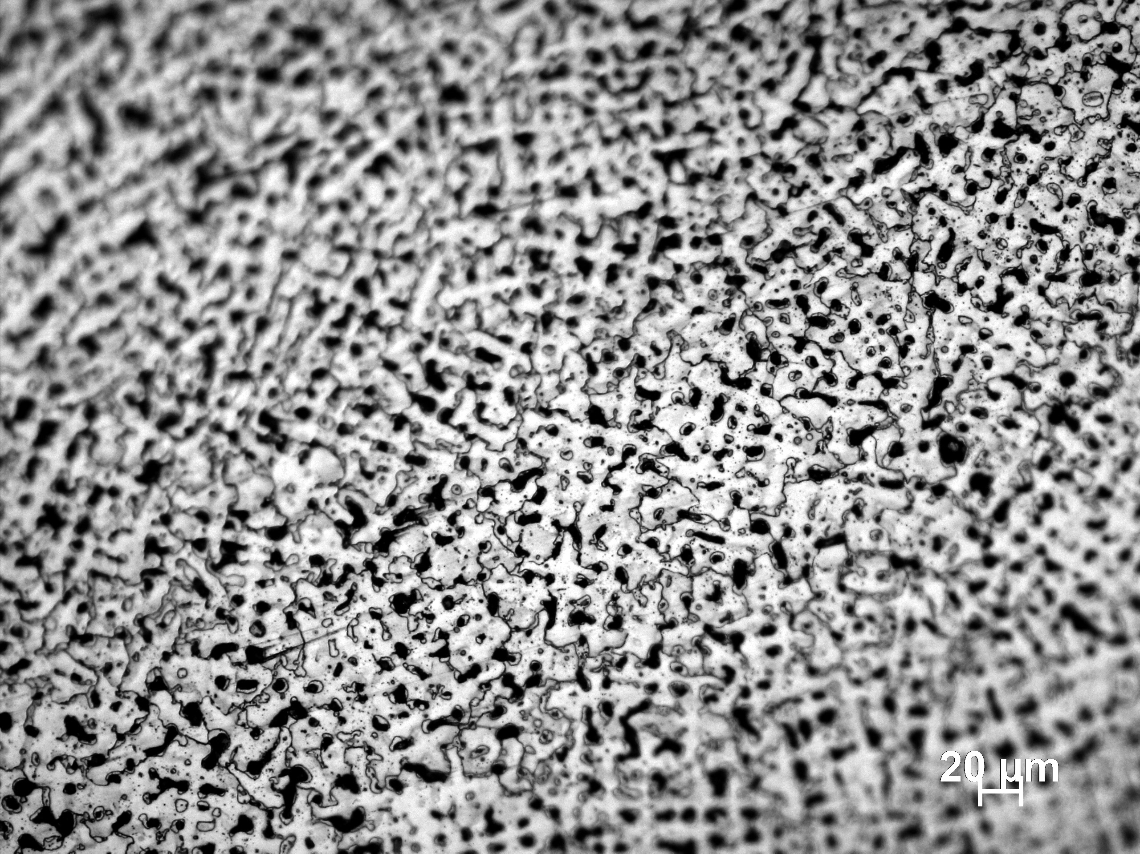
Experimental
Optical
Microstructures
100x
Cr-Cu-Fe-Co-Ni-Si
Cr-Cu-Fe-Co-Ni₂-Si
Ph.D. Defence Seminar
Cr-Cu-Fe-Co-Ni_{2.1}-Si_{0.55}

Slide 19
Experimental
Scanning Electron Microscopy (SEM)
Cr-Cu-Fe-Co-Ni₂-Si
Cr-Cu-Fe-Co-Ni-Si
Cr-Cu-Fe-Co-Ni_{2.1}-Si_{0.55}
Ph.D. Defence Seminar

Slide 20
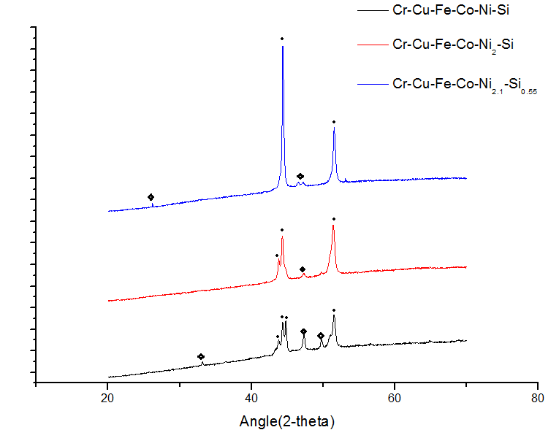
Experimental
XRD Data
● FCC
Ni₃Si
Ph.D. Defence Seminar

Slide 21
EDX
Ph.D. Defence Seminar

Slide 22
Micro-Hardness
Ph.D. Defence Seminar

Slide 23
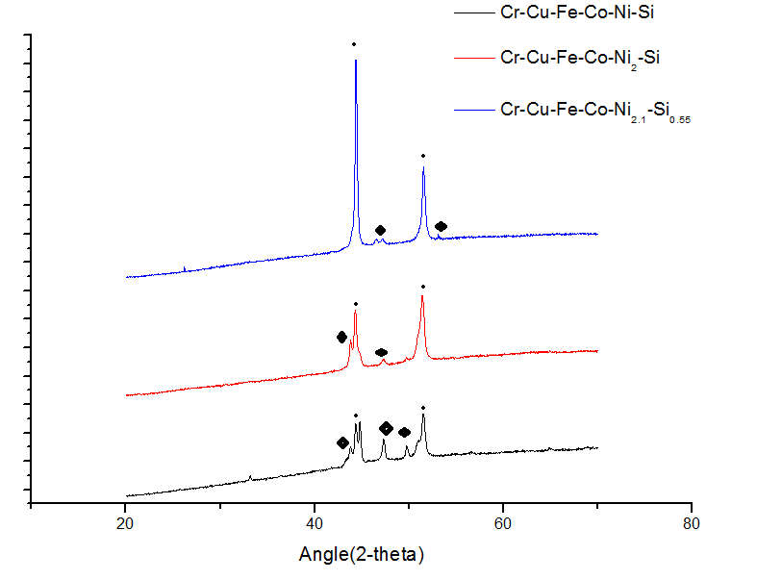
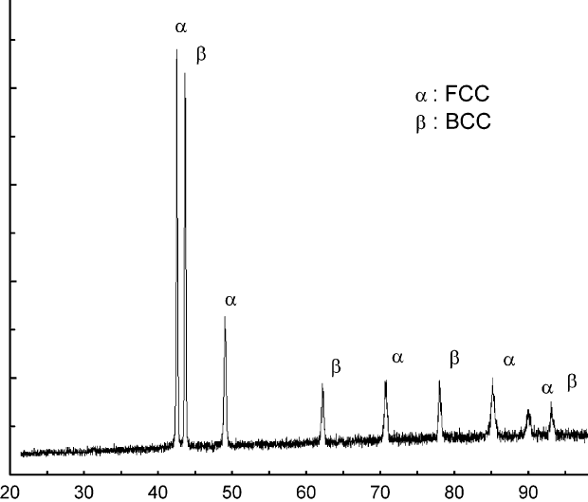
Comparision
XRD comparison with base HEA
CoCrCuFeNi
Ph.D. Defence Seminar

Slide 24
Comparision
Hardness comparison with base HEA & others
Ph.D. Defence Seminar

Slide 25
References
[1]J.W. Yeh, S.K. Chen, S.J. Lin, J.Y. Gan, T.S. Chin, T.T. Shun, C.H. Tsau, S.Y. Chang, Adv. Eng. Mater. 6 (2004) 299–303+274.
[2] Xi Jina, Yang Zhoua, Lu Zhanga, Xingyu Dua, Bangsheng Lia,b* 633–648.
[3]C.-J. Tong, Y.-L. Chen, J.-W. Yeh, S.-J. Lin, S.-K. Chen, T.-T. Shun, C.-H. Tsau, S.-Y. Chang, Metall. Mater. Trans. A 36 (2005) 881–893.
[4]A. Takeuchi, N. Chen, T. Wada, Y. Yokoyama, H. Kato, A. Inoue, J.W. Yeh, Intermetallics 19 (2011) 1546–1554.
[5]Z. Liu, S. Guo, X. Liu, J. Ye, Y. Yang, X.L. Wang, L. Yang, K. An, C.T. Liu, Scr. Mater. 64 (2011) 868–871.
[6] F. Otto, Y. Yang, H. Bei, E. P. George. Relative effects of enthalpy and entropy on
the phase stability of equiatomic high-entropy alloys, Acta Mater. 61 (2013)
2628-2638.
[7] D. B. Miracle, O. N. Senkov. A critical review of high entropy alloys and related
concepts, Acta Mater. 122 (2016) 448-511.
[8] Y. P. Lu, Y. Dong, S. Guo, L. Jiang, H. J. Kang, T. M. Wang, B. Wen, Z. J. Wang, J.
C. Jie, Z. Q. Cao, H. H Ruan, T. J. Li. A Promising New Class of High-Temperature
Alloys: Eutectic High-Entropy Alloys, Sci. Rep. 4 (2014) 6200.
Ph.D. Defence Seminar

Slide 26
Thank you
.

Slide 27
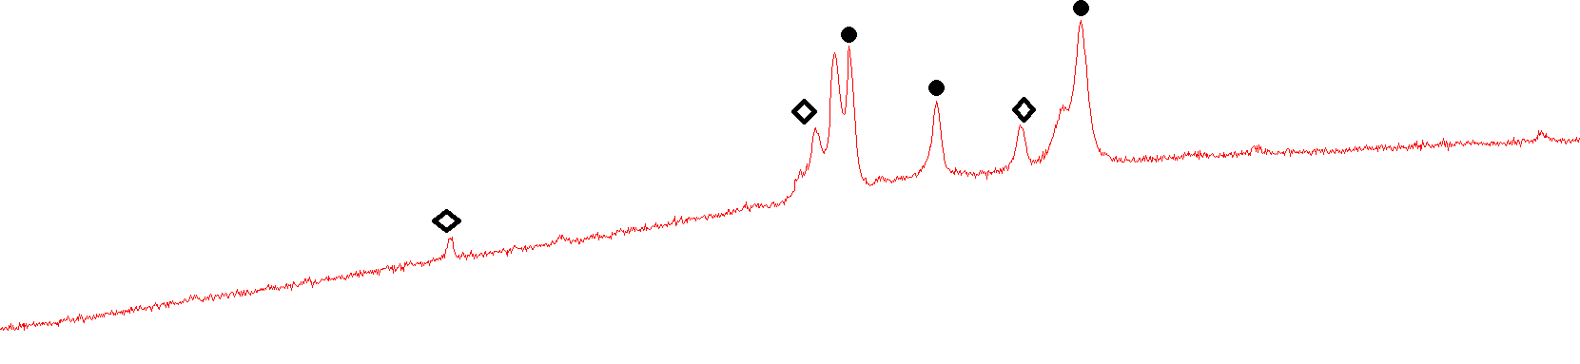
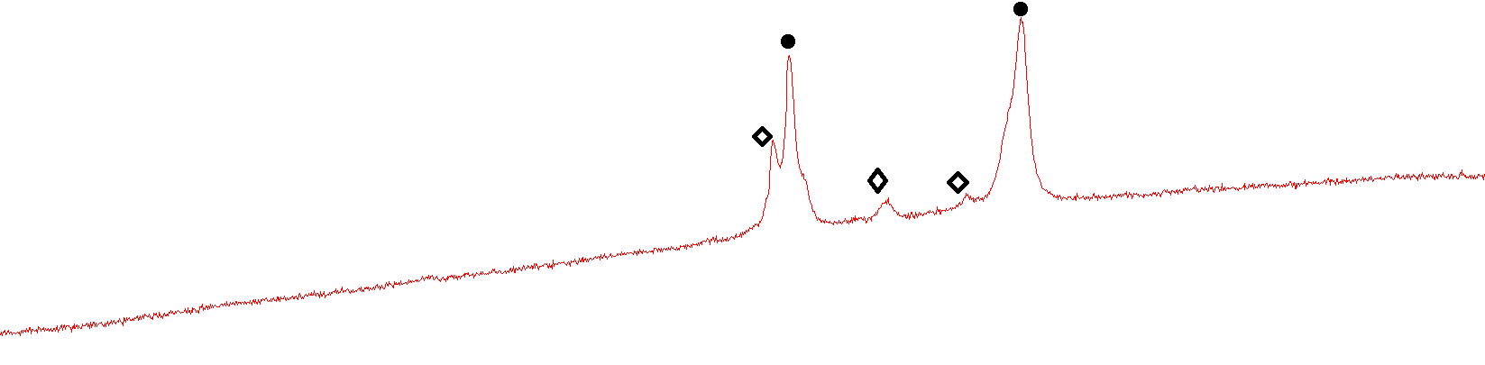
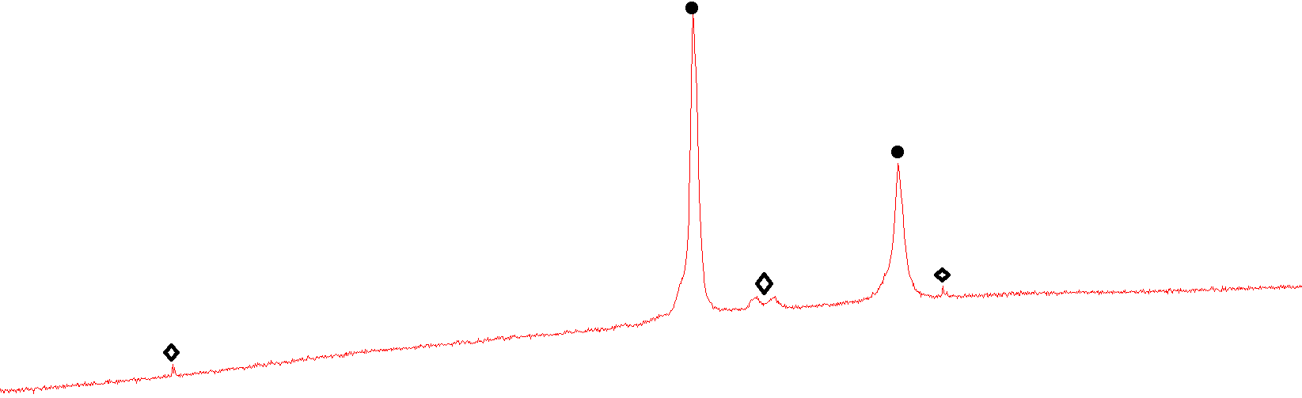
XRD Analysis
● FCC
Ni₃Si
Cr-Cu-Fe-Co-Ni-Si
Cr-Cu-Fe-Co-Ni₂-Si
Cr-Cu-Fe-Co-Ni_{2.1}-Si_{0.55}
Ph.D. Defence Seminar

Slide 28
Future Works
SEM(Scanning Electron Microscopy)
EDS analysis(Electron Dispersive Spectrometry)
DSC analysis(Differential Scanning Calorimetry)
Corrosion Test
Hardness Test
Wear Resistance Test
Ph.D. Defence Seminar

